Slide 1
Data Lake(DWH) - Hive Ingestion
Hariharan

Slide 2
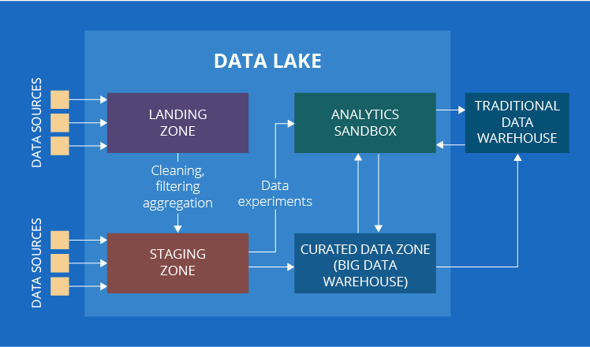
Concept

Slide 3
1. Landing zone
Here comes the data (structured, unstructured and semi-structured) that undergoes preliminary cleaning and/or filtering. For example, you collect IoT data from sensors. If one of the sensors is sending abnormally high values while the other sensors that measure the same parameter have not registered anything unusual, a processing engine deployed within this zone will mark the values as erroneous.
2. Staging zone
There are two ways for data to appear in the staging zone. First, it can come from the landing zone (if any), like the sensor data from our previous example. Secondly, we can get data, which does not require any preprocessing, from other internal or external data sources. Customer comments in social networks will be a good example to illustrate this case.
3. Analytics sandbox
This is the zone for data experiments driven by data analysts. It is different from the analytics as we know it, as its findings (if any) are not directly used by business. By the way, we deliberately specified this if any. It happens quite often that analysts apply some models or algorithms to raw data (which may also be coupled with the data from a big data warehouse or from other internal or external data sources) and get no valuable findings. For exploratory data analytics, this is normal.

Slide 4
4. Curated data zone
By now, our list should have been over, if there weren’t one slight hitch. In some sources, you may come upon one more component of a data lake – the curated data zone. This is the zone with organized data ready for data analysis. Also known as big data warehouse.

Slide 5
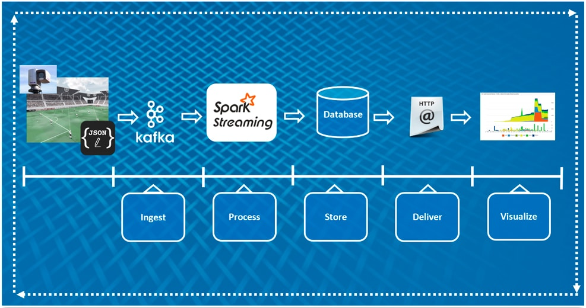

Slide 6
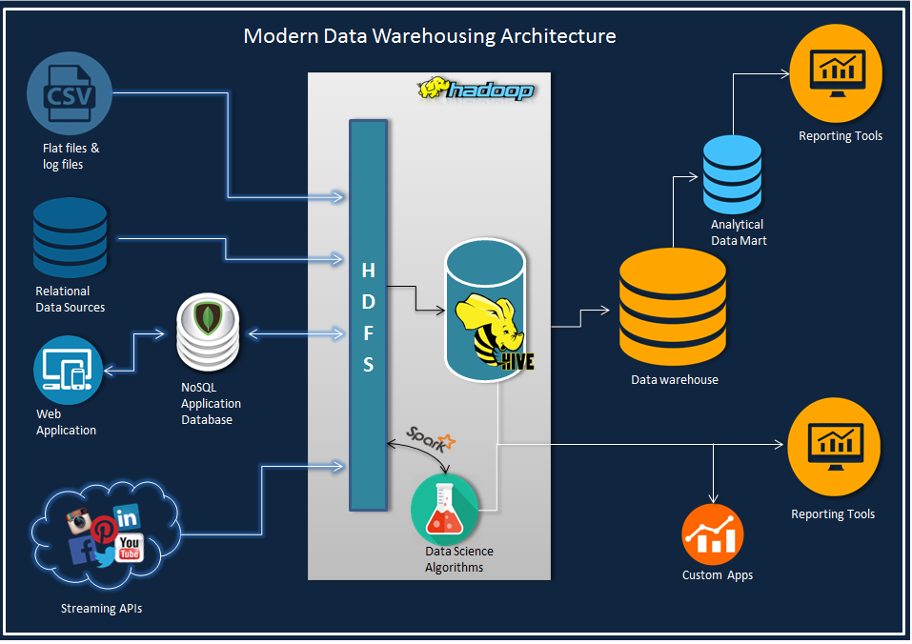

Slide 7
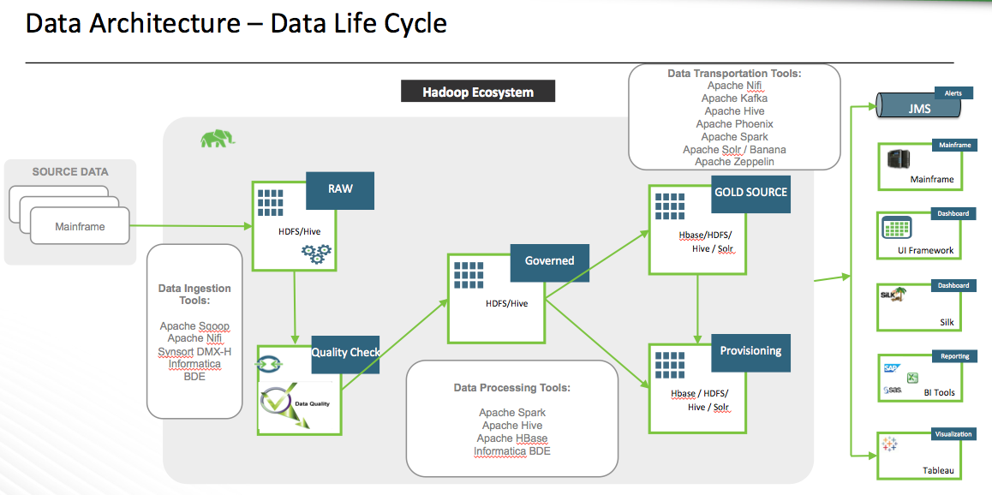

Slide 8
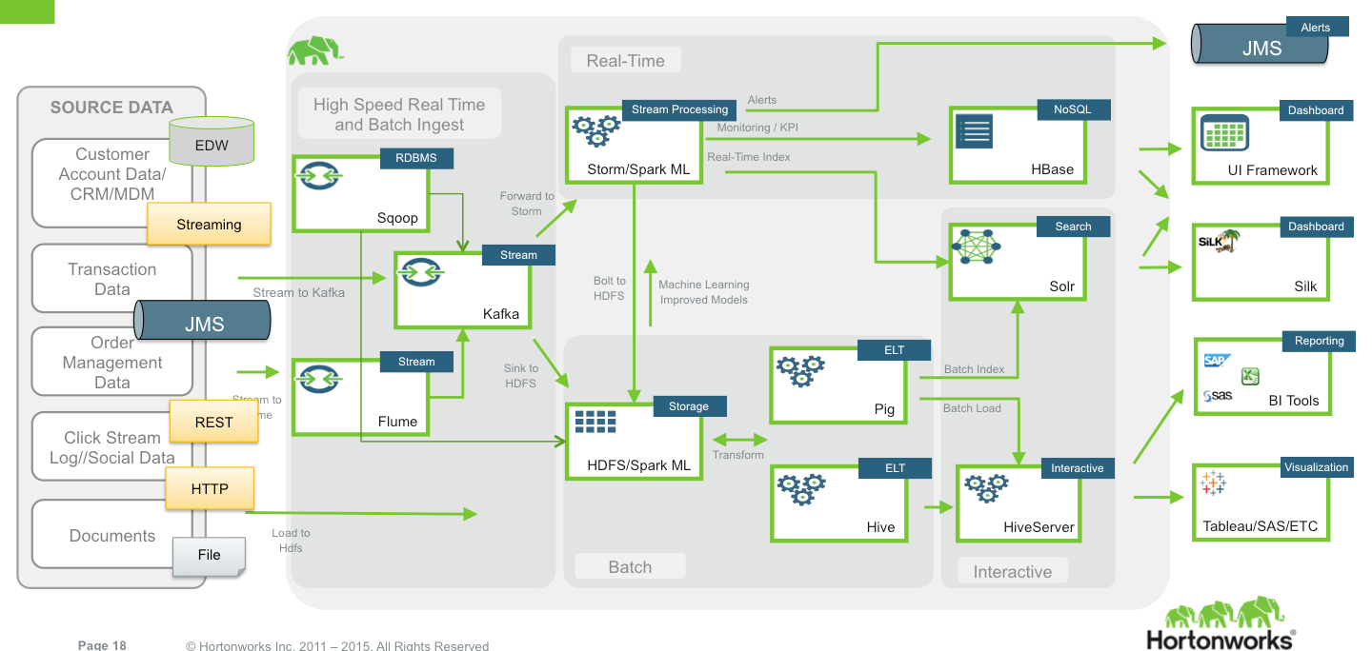

Slide 9
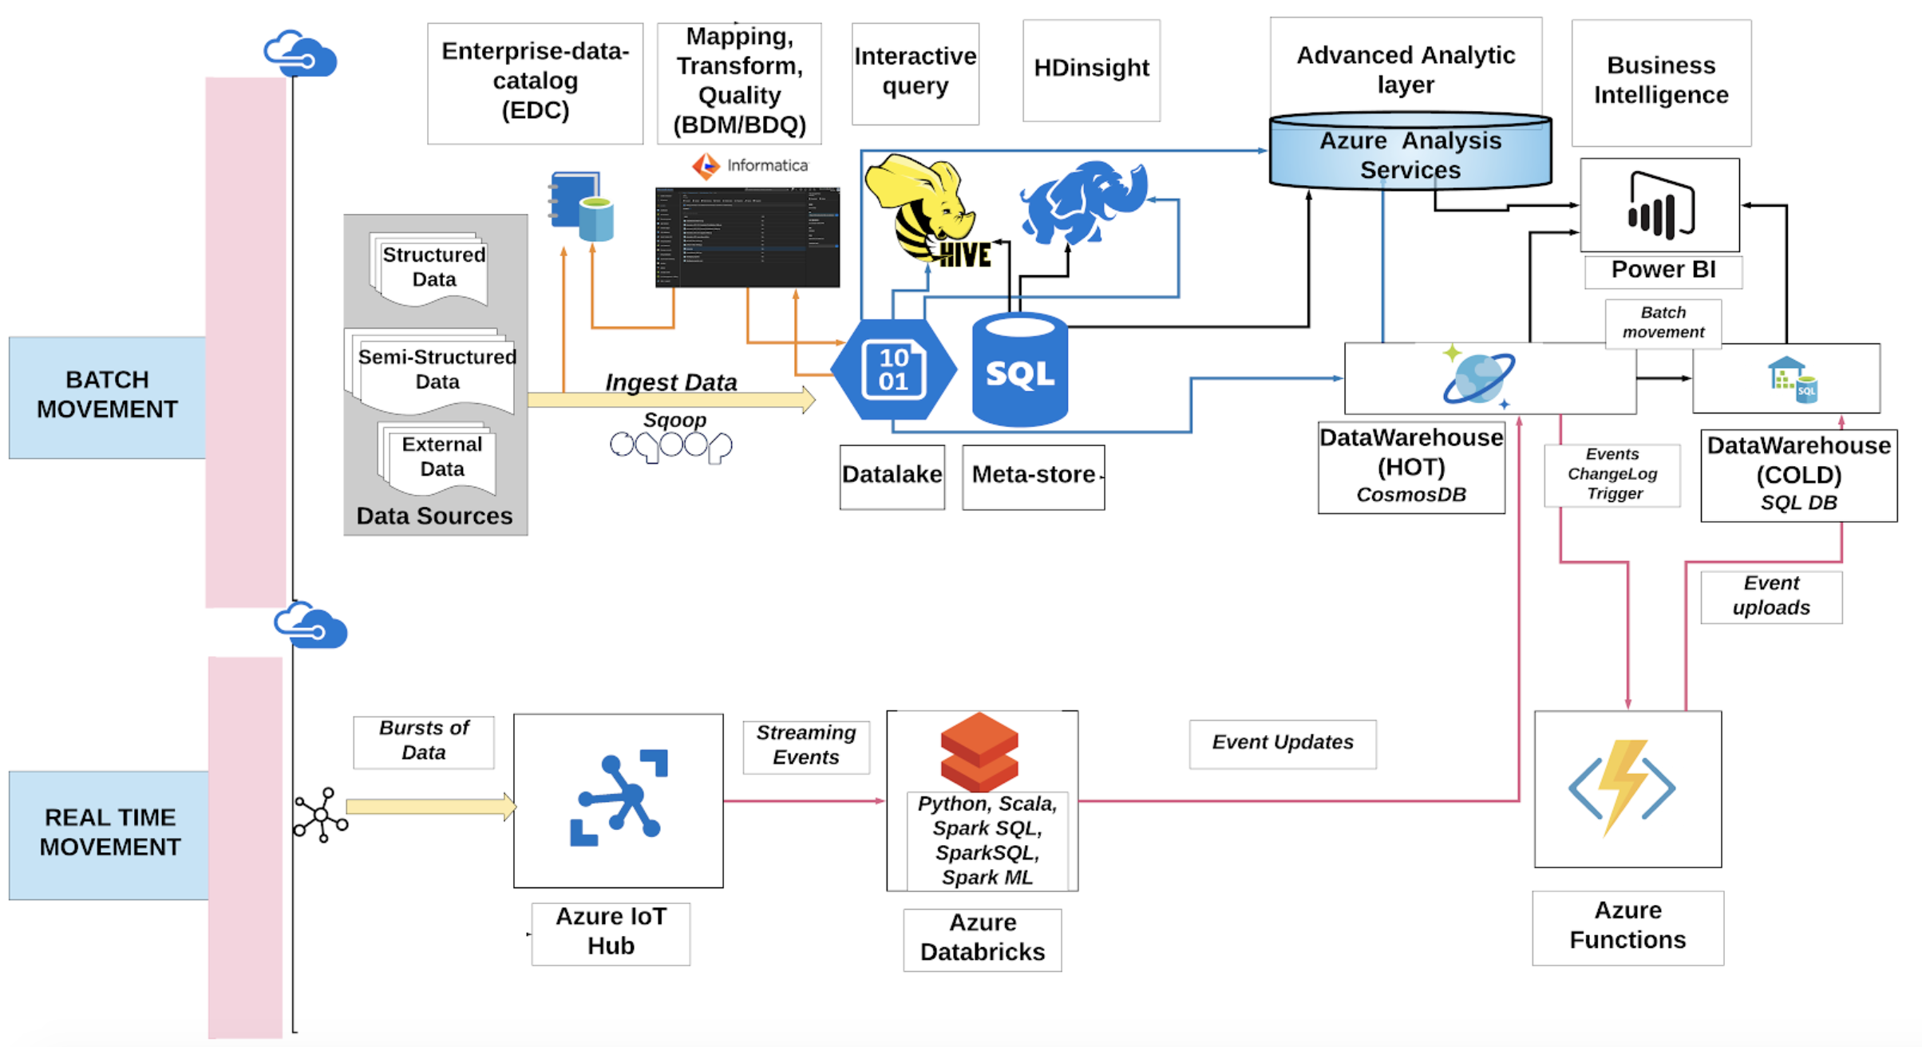

Slide 10
Scenario 1
Batch
Daily File of delta data. (ins/upd/del)
Daily Full File
Daily Update data
/user/Hadoop/landingzone/Company-ins/<Auto>/<Tesla>/<2020>/<09>/22/
/user/Hadoop/landingzone/Hospitals/<>/<>/<>/<>
Load the data into HIVE
Just adding the partition
Spark Job
To clean ,filter,aggregate
Store the Staging data in Hive
/user/Hadoop/Stagingzone/
Key
All rows are insert 100
TS
Insert update strategy
3 insert (101,102,103)
2 del(99,100)
2 updates(80,81)

Slide 11
